Slide 1
Action based research
Innovation Projects
Innovation encourages to explore, research and use all the tools to uncover something new. It involves a different way of looking at problems and solving them. The thinking process that goes into it will help develop creativity and problem solving skills.

Slide 2
Importance of Academic scores
Sense of Accomplishment
Learning Important life Skills
Good University
Increase in Self-confidence
Career Opportunities
Sense of Satisfaction

Slide 3

Variations are normal

Slide 4
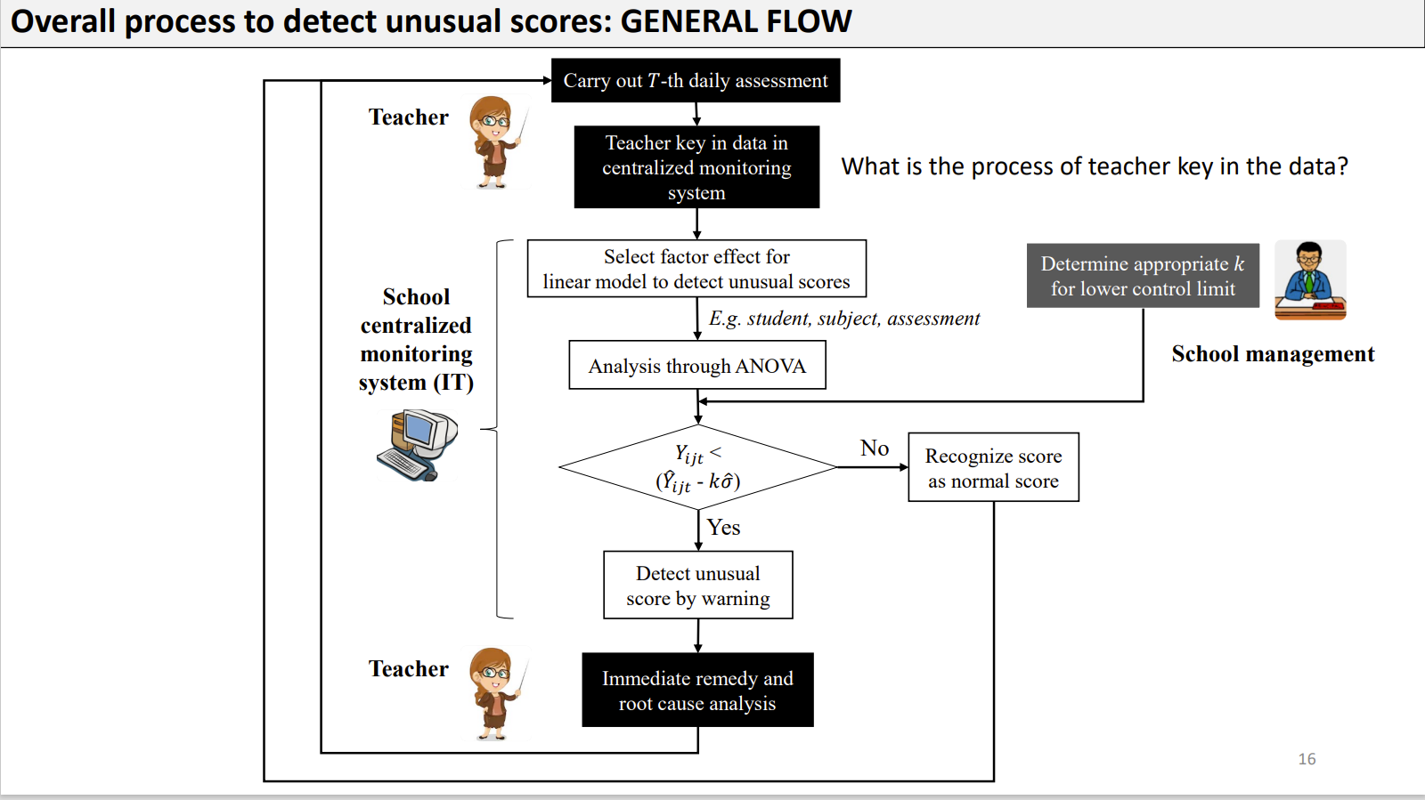
Equation – Anova Model

Slide 5
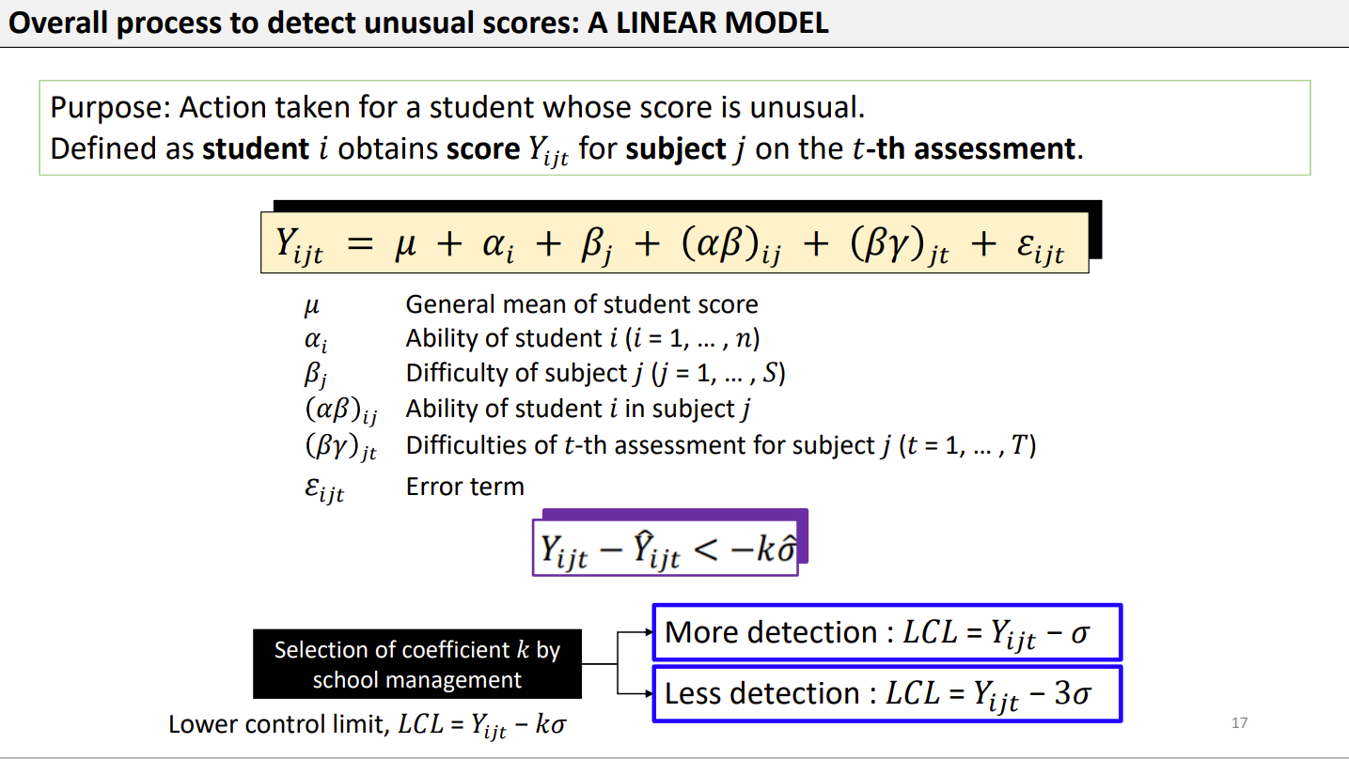
Variations are normal

Slide 6
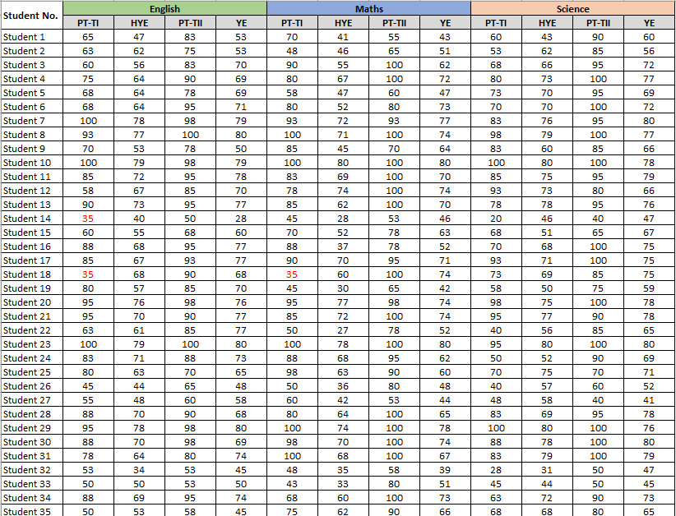
Data collected (Sample)
Noida | Grade - 8A
Abbr. | Full Form
PT - TI | Periodic Test – Term 1
HYE | Half Yearly Exam
PT – TII | Periodic Test – Term 2
YE | Yearly Exam
Note: For late joiners/absent, we have taken the score as 35 for calculation purpose

Slide 7
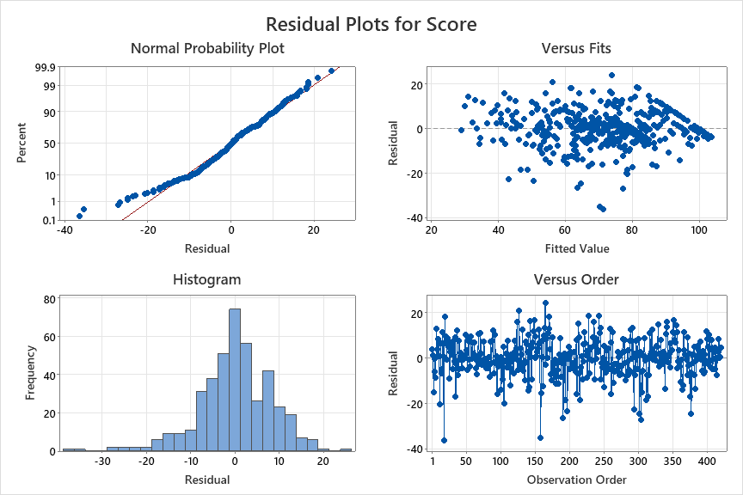
Normality Test
Normality Test | Noida| Grade - 8A

Slide 8
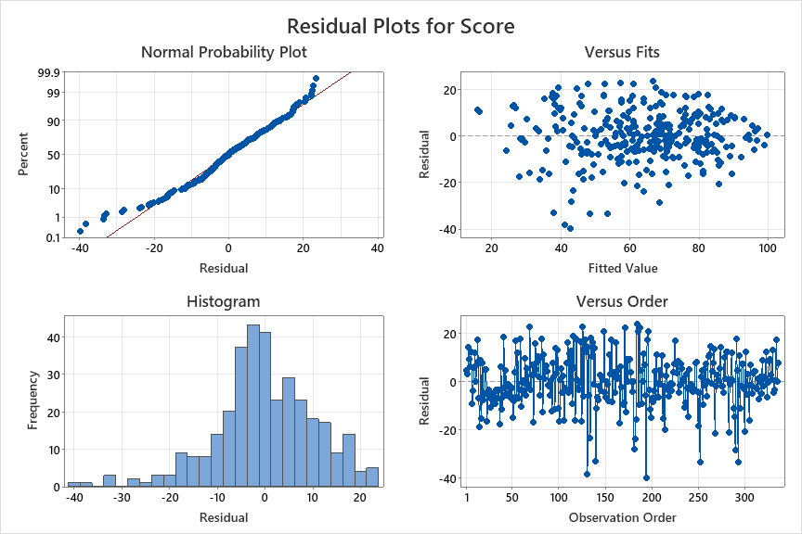
Normality Test
Normality Test | Noida| Grade – 8B

Slide 9
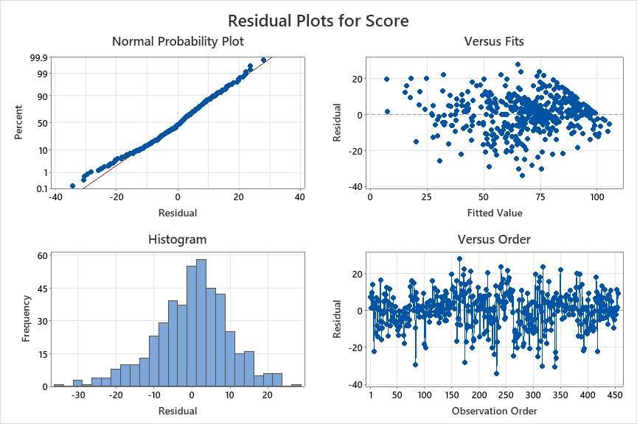
Normality Test
Normality Test | Noida| Grade – 8C

Slide 10
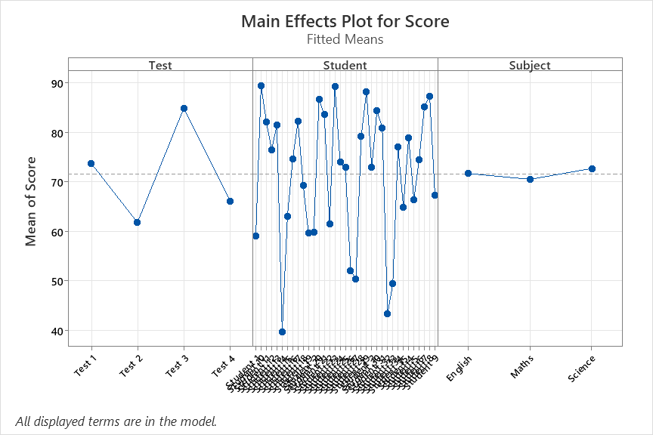
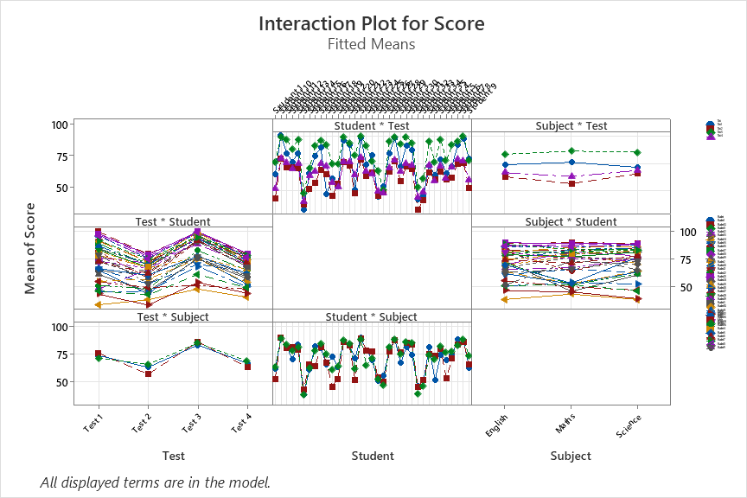
Behavior of Variables
Normality Test – Noida | Grade 8A

Slide 11
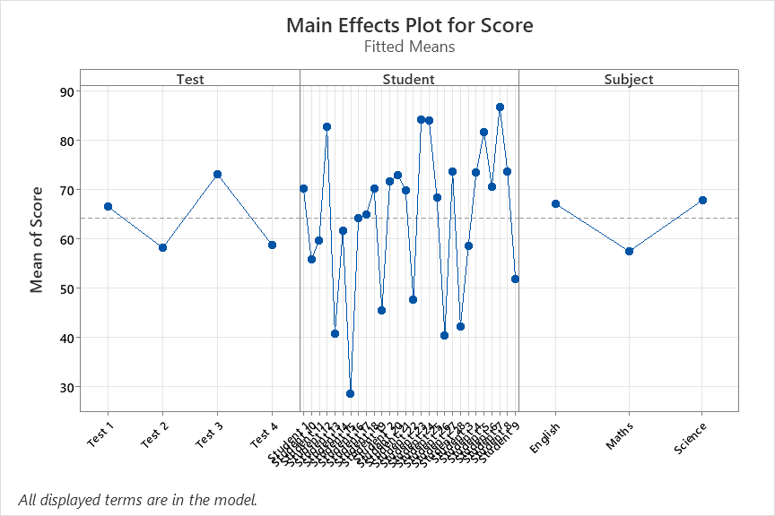
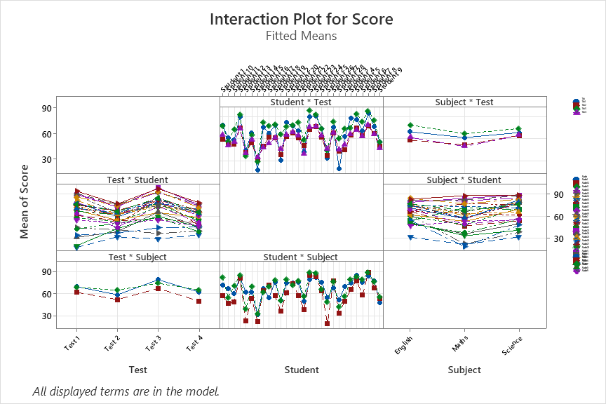
Behavior of Variables
Normality Test – Noida | Grade 8B

Slide 12
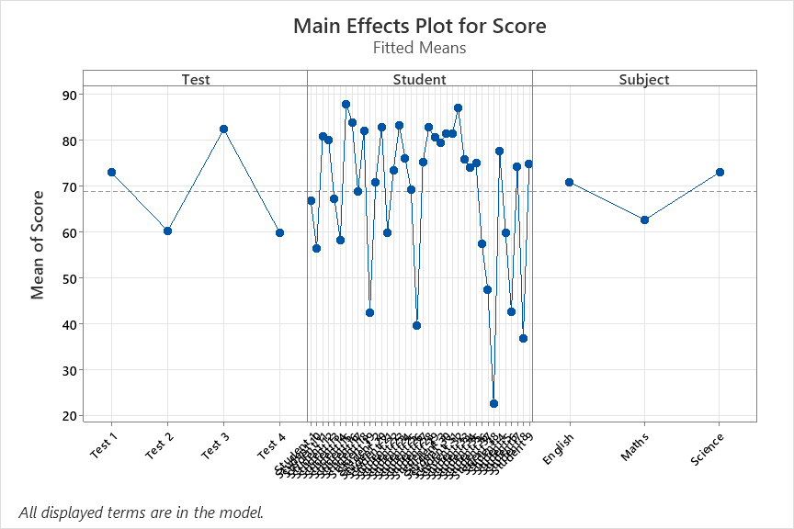
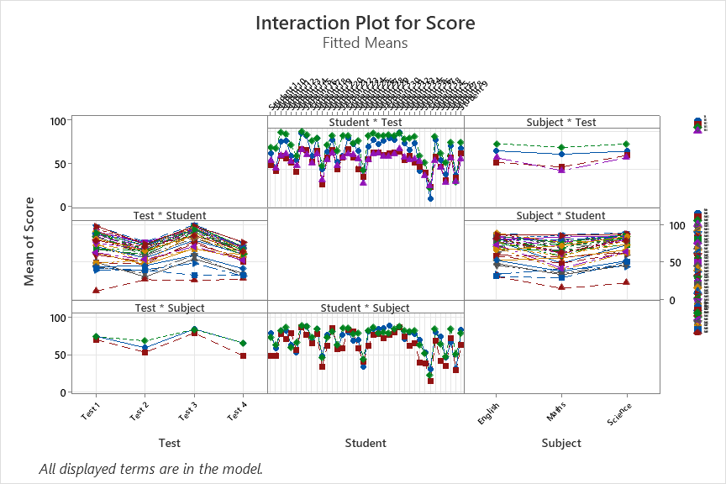
Behavior of Variables
Normality Test – Noida | Grade 8C

Slide 13
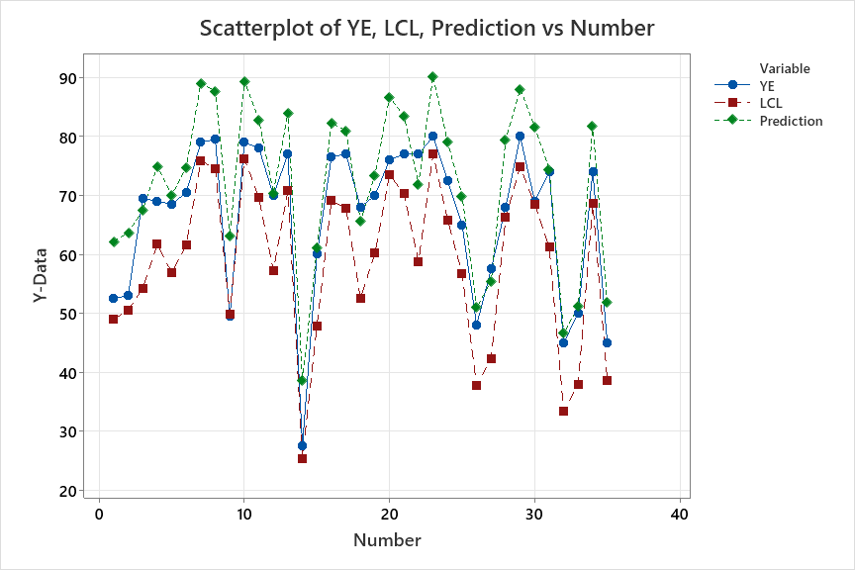
Judgement based on Anova Analysis
Noida Campus - 8A (English)
Student Assessment | PT-TI | HYE | PT-TII | YE | LCL (Ŷi13 - 2σ) | Judgment | (Ŷi10) Predicted score
Student 1 | 65 | 47 | 83 | 53 | 49 | normal | 62
Student 2 | 63 | 62 | 75 | 53 | 50 | normal | 64
Student 3 | 60 | 56 | 83 | 70 | 54 | normal | 67
Student 4 | 75 | 64 | 90 | 69 | 62 | normal | 75
Student 5 | 68 | 64 | 78 | 69 | 57 | normal | 70
Student 6 | 68 | 64 | 95 | 71 | 62 | normal | 75
Student 7 | 100 | 78 | 98 | 79 | 76 | normal | 89
Student 8 | 93 | 77 | 100 | 80 | 74 | normal | 88
Student 9 | 70 | 53 | 78 | 50 | 50 | warning | 63
Student 10 | 100 | 79 | 98 | 79 | 76 | normal | 89
Student 11 | 85 | 72 | 95 | 78 | 70 | normal | 83
Student 12 | 58 | 67 | 85 | 70 | 57 | normal | 70
Student 13 | 90 | 73 | 95 | 77 | 71 | normal | 84
Student 14 | 35 | 40 | 50 | 28 | 25 | normal | 39
Student 15 | 60 | 55 | 68 | 60 | 48 | normal | 61
Student 16 | 88 | 68 | 95 | 77 | 69 | normal | 82
Student 17 | 85 | 67 | 93 | 77 | 68 | normal | 81
Student 18 | 35 | 68 | 90 | 68 | 52 | normal | 66
Student 19 | 80 | 57 | 85 | 70 | 60 | normal | 73
Student 20 | 95 | 76 | 98 | 76 | 73 | normal | 87
Student 21 | 95 | 70 | 90 | 77 | 70 | normal | 83
Student 22 | 63 | 61 | 85 | 77 | 59 | normal | 72
Student 23 | 100 | 79 | 100 | 80 | 77 | normal | 90
Student 24 | 83 | 71 | 88 | 73 | 66 | normal | 79
Student 25 | 80 | 63 | 70 | 65 | 57 | normal | 70
Student 26 | 45 | 44 | 65 | 48 | 38 | normal | 51
Student 27 | 55 | 48 | 60 | 58 | 42 | normal | 55
Student 28 | 88 | 70 | 90 | 68 | 66 | normal | 79
Student 29 | 95 | 78 | 98 | 80 | 75 | normal | 88
Student 30 | 88 | 70 | 98 | 69 | 68 | normal | 82
Student 31 | 78 | 64 | 80 | 74 | 61 | normal | 74
Student 32 | 53 | 34 | 53 | 45 | 33 | normal | 47
Student 33 | 50 | 50 | 53 | 50 | 38 | normal | 51
Student 34 | 88 | 69 | 95 | 74 | 69 | normal | 82
Student 35 | 50 | 53 | 58 | 45 | 39 | normal | 52

Slide 14
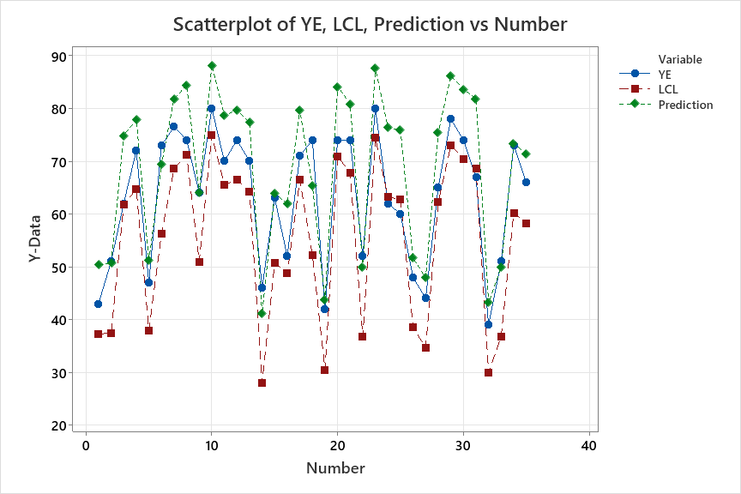
Judgement based on Anova Analysis
Noida Campus - 8A (Maths)
Student Assessment | PT-TI | HYE | PT-TII | YE | LCL (Ŷi13 - 2σ) | Judgment | (Ŷi10) Predicted score
Student 1 | 70 | 41 | 55 | 43 | 37 | normal | 50
Student 2 | 48 | 46 | 65 | 51 | 37 | normal | 51
Student 3 | 90 | 55 | 100 | 62 | 62 | normal | 75
Student 4 | 80 | 67 | 100 | 72 | 65 | normal | 78
Student 5 | 58 | 47 | 60 | 47 | 38 | normal | 51
Student 6 | 80 | 52 | 80 | 73 | 56 | normal | 69
Student 7 | 93 | 72 | 93 | 77 | 69 | normal | 82
Student 8 | 100 | 71 | 100 | 74 | 71 | normal | 84
Student 9 | 85 | 45 | 70 | 64 | 51 | normal | 64
Student 10 | 100 | 80 | 100 | 80 | 75 | normal | 88
Student 11 | 83 | 69 | 100 | 70 | 65 | normal | 79
Student 12 | 78 | 74 | 100 | 74 | 66 | normal | 80
Student 13 | 85 | 62 | 100 | 70 | 64 | normal | 77
Student 14 | 45 | 28 | 53 | 46 | 28 | normal | 41
Student 15 | 70 | 52 | 78 | 63 | 51 | normal | 64
Student 16 | 88 | 37 | 78 | 52 | 49 | normal | 62
Student 17 | 90 | 70 | 95 | 71 | 66 | normal | 80
Student 18 | 35 | 60 | 100 | 74 | 52 | normal | 65
Student 19 | 45 | 30 | 65 | 42 | 30 | normal | 44
Student 20 | 95 | 77 | 98 | 74 | 71 | normal | 84
Student 21 | 85 | 72 | 100 | 74 | 68 | normal | 81
Student 22 | 50 | 27 | 78 | 52 | 37 | normal | 50
Student 23 | 100 | 78 | 100 | 80 | 74 | normal | 88
Student 24 | 88 | 68 | 95 | 62 | 63 | warning | 76
Student 25 | 98 | 63 | 90 | 60 | 63 | warning | 76
Student 26 | 50 | 36 | 80 | 48 | 38 | normal | 52
Student 27 | 60 | 42 | 53 | 44 | 35 | normal | 48
Student 28 | 80 | 64 | 100 | 65 | 62 | normal | 75
Student 29 | 100 | 74 | 100 | 78 | 73 | normal | 86
Student 30 | 98 | 70 | 100 | 74 | 70 | normal | 84
Student 31 | 100 | 68 | 100 | 67 | 69 | warning | 82
Student 32 | 48 | 35 | 58 | 39 | 30 | normal | 43
Student 33 | 43 | 33 | 80 | 51 | 37 | normal | 50
Student 34 | 68 | 60 | 100 | 73 | 60 | normal | 73
Student 35 | 75 | 62 | 90 | 66 | 58 | normal | 71

Slide 15
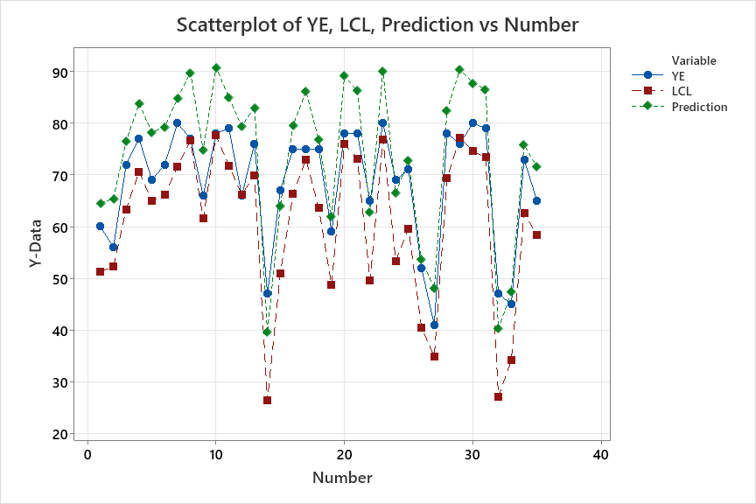
Judgement based on Anova Analysis
Noida Campus - 8A (Science)
Student Assessment | PT-TI | HYE | PT-TII | YE | LCL (Ŷi13 - 2σ) | Judgment | (Ŷi10) Predicted score
Student 1 | 60 | 43 | 90 | 60 | 51 | normal | 65
Student 2 | 53 | 62 | 85 | 56 | 52 | normal | 65
Student 3 | 68 | 66 | 95 | 72 | 63 | normal | 77
Student 4 | 80 | 73 | 100 | 77 | 71 | normal | 84
Student 5 | 73 | 70 | 95 | 69 | 65 | normal | 78
Student 6 | 70 | 70 | 100 | 72 | 66 | normal | 79
Student 7 | 83 | 76 | 95 | 80 | 72 | normal | 85
Student 8 | 98 | 79 | 100 | 77 | 77 | normal | 90
Student 9 | 83 | 60 | 85 | 66 | 62 | normal | 75
Student 10 | 100 | 80 | 100 | 78 | 78 | normal | 91
Student 11 | 85 | 75 | 95 | 79 | 72 | normal | 85
Student 12 | 93 | 73 | 80 | 66 | 66 | warning | 79
Student 13 | 78 | 78 | 95 | 76 | 70 | normal | 83
Student 14 | 20 | 46 | 40 | 47 | 26 | normal | 40
Student 15 | 68 | 51 | 65 | 67 | 51 | normal | 64
Student 16 | 70 | 68 | 100 | 75 | 66 | normal | 80
Student 17 | 93 | 71 | 100 | 75 | 73 | normal | 86
Student 18 | 73 | 69 | 85 | 75 | 64 | normal | 77
Student 19 | 58 | 50 | 75 | 59 | 49 | normal | 62
Student 20 | 98 | 75 | 100 | 78 | 76 | normal | 89
Student 21 | 95 | 77 | 90 | 78 | 73 | normal | 86
Student 22 | 40 | 56 | 85 | 65 | 50 | normal | 63
Student 23 | 95 | 80 | 100 | 80 | 77 | normal | 90
Student 24 | 50 | 52 | 90 | 69 | 53 | normal | 67
Student 25 | 70 | 75 | 70 | 71 | 60 | normal | 73
Student 26 | 40 | 57 | 60 | 52 | 40 | normal | 54
Student 27 | 48 | 58 | 40 | 41 | 35 | normal | 48
Student 28 | 83 | 69 | 95 | 78 | 69 | normal | 83
Student 29 | 100 | 80 | 100 | 76 | 77 | warning | 90
Student 30 | 88 | 78 | 100 | 80 | 75 | normal | 88
Student 31 | 83 | 79 | 100 | 79 | 73 | normal | 87
Student 32 | 28 | 31 | 50 | 47 | 27 | normal | 40
Student 33 | 45 | 44 | 50 | 45 | 34 | normal | 47
Student 34 | 63 | 72 | 90 | 73 | 63 | normal | 76
Student 35 | 68 | 68 | 80 | 65 | 58 | normal | 72

Slide 16
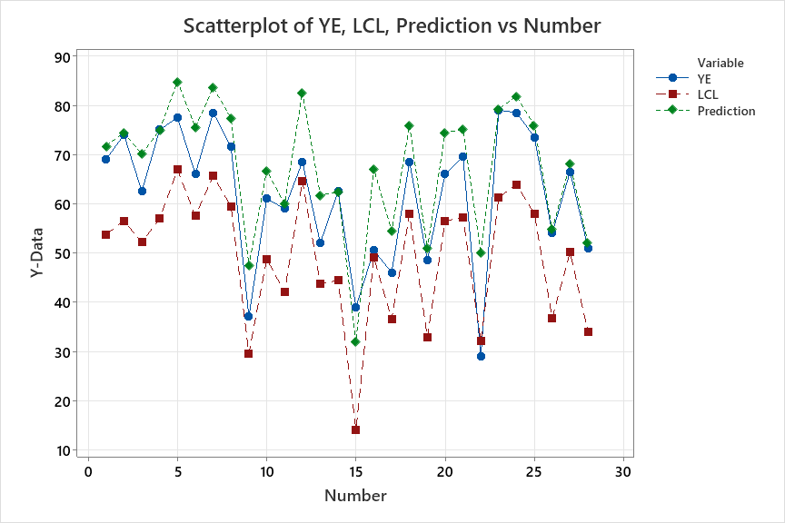
Judgement based on Anova Analysis
Noida Campus – 8B (English)
Student Assessment | PT-TI | HYE | PT-TII | YE | LCL (Ŷi13 - 2σ) | Judgment | (Ŷi10) Predicted score
Student 1 | 75 | 69 | 75 | 69 | 54 | normal | 72
Student 2 | 80 | 74 | 80 | 74 | 57 | normal | 74
Student 3 | 88 | 63 | 88 | 63 | 52 | normal | 70
Student 4 | 75 | 75 | 75 | 75 | 57 | normal | 75
Student 5 | 93 | 78 | 93 | 78 | 67 | normal | 85
Student 6 | 83 | 66 | 83 | 66 | 58 | normal | 75
Student 7 | 95 | 79 | 95 | 79 | 66 | normal | 84
Student 8 | 95 | 72 | 95 | 72 | 59 | normal | 77
Student 9 | 58 | 37 | 58 | 37 | 30 | normal | 47
Student 10 | 73 | 61 | 73 | 61 | 49 | normal | 67
Student 11 | 70 | 59 | 70 | 59 | 42 | normal | 60
Student 12 | 93 | 69 | 93 | 69 | 65 | normal | 83
Student 13 | 75 | 52 | 75 | 52 | 44 | normal | 62
Student 14 | 70 | 63 | 70 | 63 | 44 | normal | 62
Student 15 | 43 | 39 | 43 | 39 | 14 | normal | 32
Student 16 | 83 | 51 | 83 | 51 | 49 | normal | 67
Student 17 | 60 | 46 | 60 | 46 | 37 | normal | 54
Student 18 | 85 | 69 | 85 | 69 | 58 | normal | 76
Student 19 | 73 | 49 | 73 | 49 | 33 | normal | 51
Student 20 | 90 | 66 | 90 | 66 | 57 | normal | 74
Student 21 | 90 | 70 | 90 | 70 | 57 | normal | 75
Student 22 | 70 | 29 | 70 | 29 | 32 | warning | 50
Student 23 | 98 | 79 | 98 | 79 | 61 | normal | 79
Student 24 | 90 | 79 | 90 | 79 | 64 | normal | 82
Student 25 | 90 | 74 | 90 | 74 | 58 | normal | 76
Student 26 | 70 | 54 | 70 | 54 | 37 | normal | 55
Student 27 | 73 | 67 | 73 | 67 | 50 | normal | 68
Student 28 | 65 | 51 | 65 | 51 | 34 | normal | 52

Slide 17
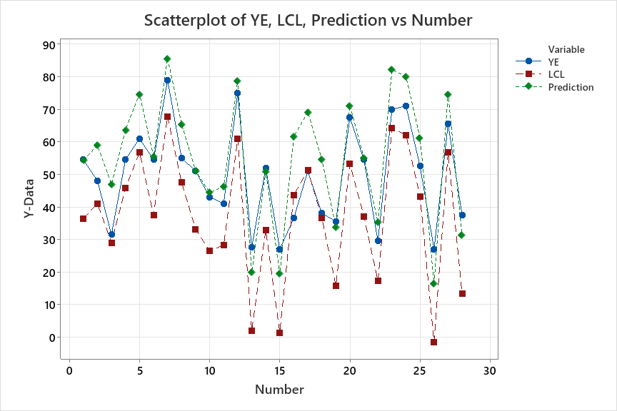
Judgement based on Anova Analysis
Noida Campus – 8B (Maths)
Student Assessment | PT-TI | HYE | PT-TII | YE | LCL (Ŷi23 - 2σ) | Judgment | (Ŷi10) Predicted score
Student 1 | 63 | 47 | 63 | 55 | 36 | normal | 54
Student 2 | 80 | 53 | 65 | 48 | 41 | normal | 59
Student 3 | 45 | 38 | 83 | 32 | 29 | normal | 47
Student 4 | 88 | 59 | 63 | 55 | 46 | normal | 64
Student 5 | 83 | 72 | 93 | 61 | 57 | normal | 75
Student 6 | 50 | 54 | 73 | 55 | 37 | normal | 55
Student 7 | 100 | 76 | 98 | 79 | 68 | normal | 86
Student 8 | 70 | 62 | 85 | 55 | 47 | normal | 65
Student 9 | 45 | 60 | 58 | 51 | 33 | normal | 51
Student 10 | 48 | 39 | 58 | 43 | 26 | normal | 44
Student 11 | 55 | 41 | 58 | 41 | 28 | normal | 46
Student 12 | 95 | 70 | 85 | 75 | 61 | normal | 79
Student 13 | 20 | 27 | 15 | 28 | 2 | normal | 20
Student 14 | 80 | 41 | 40 | 52 | 33 | normal | 51
Student 15 | 18 | 27 | 15 | 27 | 1 | normal | 19
Student 16 | 75 | 55 | 90 | 37 | 44 | warning | 62
Student 17 | 78 | 70 | 88 | 51 | 51 | warning | 69
Student 18 | 78 | 49 | 63 | 38 | 37 | normal | 55
Student 19 | 3 | 36 | 70 | 36 | 16 | normal | 34
Student 20 | 83 | 64 | 80 | 68 | 53 | normal | 71
Student 21 | 60 | 53 | 63 | 55 | 37 | normal | 55
Student 22 | 20 | 51 | 50 | 30 | 17 | normal | 35
Student 23 | 98 | 73 | 98 | 70 | 64 | normal | 82
Student 24 | 90 | 76 | 93 | 71 | 62 | normal | 80
Student 25 | 80 | 57 | 65 | 53 | 43 | normal | 61
Student 26 | 35 | 11 | 3 | 27 | -2 | normal | 16
Student 27 | 83 | 67 | 93 | 66 | 57 | normal | 75
Student 28 | 5 | 27 | 65 | 38 | 13 | normal | 31

Slide 18
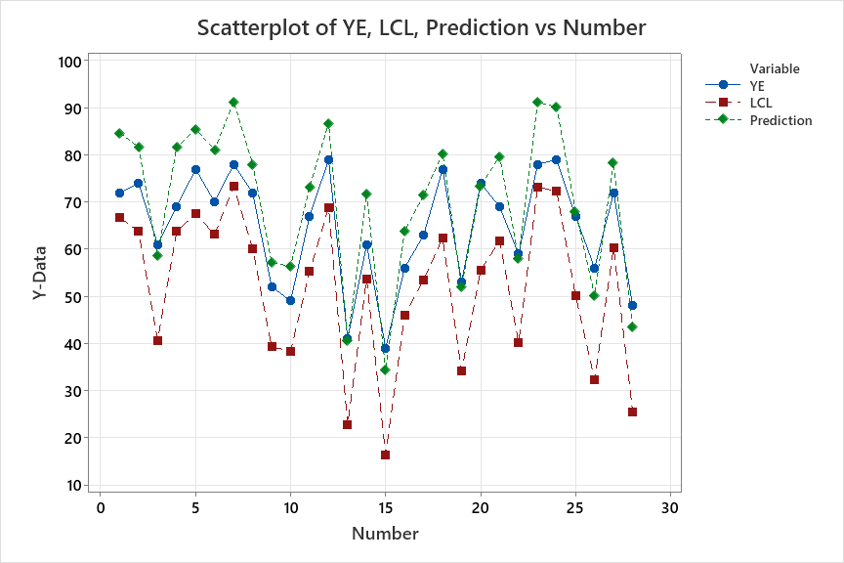
Judgement based on Anova Analysis
Noida Campus – 8B (Science)
Student Assessment | PT-TI | HYE | PT-TII | YE | LCL (Ŷi33 - 2σ) | Judgment | (Ŷi10) Predicted score
Student 1 | 93 | 70 | 95 | 72 | 67 | normal | 85
Student 2 | 85 | 74 | 85 | 74 | 64 | normal | 82
Student 3 | 68 | 47 | 50 | 61 | 41 | normal | 59
Student 4 | 88 | 76 | 85 | 69 | 64 | normal | 82
Student 5 | 83 | 78 | 95 | 77 | 68 | normal | 85
Student 6 | 75 | 76 | 95 | 70 | 63 | normal | 81
Student 7 | 100 | 79 | 100 | 78 | 73 | normal | 91
Student 8 | 85 | 72 | 75 | 72 | 60 | normal | 78
Student 9 | 58 | 60 | 50 | 52 | 39 | normal | 57
Student 10 | 63 | 65 | 40 | 49 | 38 | normal | 56
Student 11 | 55 | 72 | 90 | 67 | 55 | normal | 73
Student 12 | 80 | 80 | 100 | 79 | 69 | normal | 87
Student 13 | 50 | 43 | 20 | 41 | 23 | normal | 41
Student 14 | 65 | 67 | 85 | 61 | 54 | normal | 72
Student 15 | 20 | 40 | 30 | 39 | 16 | normal | 34
Student 16 | 75 | 41 | 75 | 56 | 46 | normal | 64
Student 17 | 68 | 61 | 85 | 63 | 54 | normal | 71
Student 18 | 75 | 71 | 90 | 77 | 62 | normal | 80
Student 19 | 48 | 44 | 55 | 53 | 34 | normal | 52
Student 20 | 75 | 71 | 65 | 74 | 56 | normal | 73
Student 21 | 73 | 73 | 95 | 69 | 62 | normal | 80
Student 22 | 50 | 60 | 55 | 59 | 40 | normal | 58
Student 23 | 98 | 80 | 100 | 78 | 73 | normal | 91
Student 24 | 98 | 80 | 95 | 79 | 72 | normal | 90
Student 25 | 70 | 62 | 65 | 67 | 50 | normal | 68
Student 26 | 28 | 48 | 60 | 56 | 32 | normal | 50
Student 27 | 75 | 73 | 85 | 72 | 60 | normal | 78
Student 28 | 15 | 52 | 50 | 48 | 26 | normal | 43

Slide 19
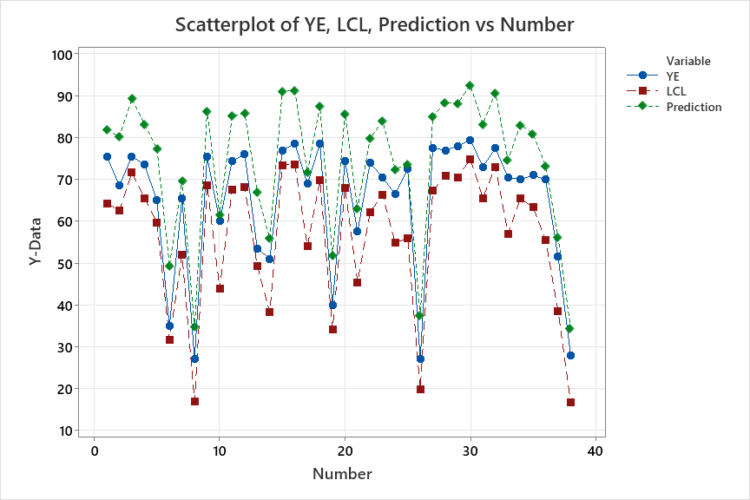
Judgement based on Anova Analysis
Noida Campus – 8C (English)
Student Assessment | PT-TI | HYE | PT-TII | YE | LCL (Ŷi13 - 2σ) | Judgment | (Ŷi10) Predicted score
Student 1 | 80 | 60 | 98 | 76 | 64 | normal | 82
Student 2 | 78 | 67 | 93 | 69 | 63 | normal | 80
Student 3 | 95 | 73 | 100 | 76 | 72 | normal | 89
Student 4 | 85 | 67 | , | 74 | 66 | normal | 83
Student 5 | 80 | 60 | 90 | 65 | 60 | normal | 77
Student 6 | 53 | 30 | 65 | 35 | 32 | normal | 49
Student 7 | 58 | 61 | 80 | 66 | 52 | normal | 70
Student 8 | 45 | 29 | 23 | 27 | 17 | normal | 35
Student 9 | 85 | 71 | 100 | 76 | 69 | normal | 86
Student 10 | 50 | 44 | 78 | 60 | 44 | normal | 62
Student 11 | 88 | 66 | 98 | 75 | 68 | normal | 85
Student 12 | 93 | 65 | 95 | 76 | 68 | normal | 86
Student 13 | 65 | 50 | 85 | 54 | 49 | normal | 67
Student 14 | 50 | 38 | 70 | 51 | 38 | normal | 56
Student 15 | 95 | 78 | 100 | 77 | 73 | normal | 91
Student 16 | 95 | 77 | 100 | 79 | 74 | normal | 91
Student 17 | 65 | 54 | 85 | 69 | 54 | normal | 72
Student 18 | 88 | 71 | 98 | 79 | 70 | normal | 87
Student 19 | 65 | 30 | 58 | 40 | 34 | normal | 52
Student 20 | 83 | 71 | 100 | 75 | 68 | normal | 86
Student 21 | 50 | 53 | 78 | 58 | 45 | normal | 63
Student 22 | 70 | 63 | 98 | 74 | 62 | normal | 80
Student 23 | 83 | 73 | 95 | 71 | 66 | normal | 84
Student 24 | 80 | 56 | 73 | 67 | 55 | normal | 72
Student 25 | 80 | 45 | 83 | 73 | 56 | normal | 74
Student 26 | 45 | 29 | 35 | 27 | 20 | normal | 37
Student 27 | 90 | 70 | 88 | 78 | 67 | normal | 85
Student 28 | 88 | 75 | 100 | 77 | 71 | normal | 88
Student 29 | 95 | 66 | 100 | 78 | 71 | normal | 88
Student 30 | 100 | 77 | 100 | 80 | 75 | normal | 93
Student 31 | 80 | 71 | 95 | 73 | 66 | normal | 83
Student 32 | 98 | 73 | 100 | 78 | 73 | normal | 91
Student 33 | 68 | 61 | 85 | 71 | 57 | normal | 75
Student 34 | 83 | 70 | 95 | 70 | 65 | normal | 83
Student 35 | 85 | 64 | 90 | 71 | 63 | normal | 81
Student 36 | 75 | 64 | 70 | 70 | 56 | normal | 73
Student 37 | 45 | 49 | 65 | 52 | 38 | normal | 56
Student 38 | 23 | 32 | 40 | 28 | 17 | normal | 34

Slide 20
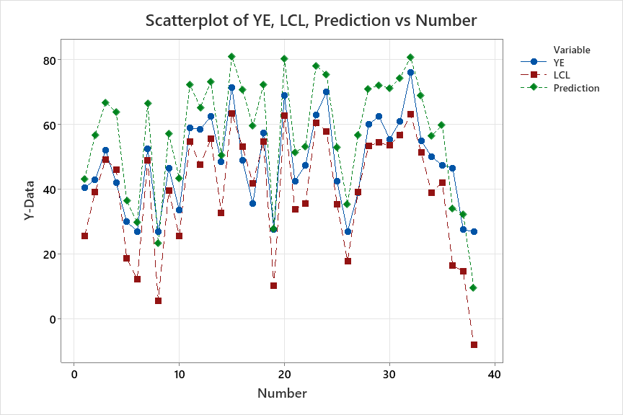
Judgement based on Anova Analysis
Noida Campus – 8C (Maths)
Student Assessment | PT-TI | HYE | PT-TII | YE | LCL (Ŷi23 - 2σ) | Judgment | (Ŷi10) Predicted score
Student 1 | 68 | 36 | 50 | 41 | 25.5 | normal | 43.2
Student 2 | 73 | 60 | 73 | 43 | 39.2 | normal | 56.8
Student 3 | 78 | 59 | 100 | 52 | 49.2 | normal | 66.8
Student 4 | 85 | 57 | 93 | 42 | 46.2 | warning | 63.8
Student 5 | 65 | 39 | 33 | 30 | 18.8 | normal | 36.4
Student 6 | 48 | 33 | 33 | 27 | 12.2 | normal | 29.8
Student 7 | 88 | 60 | 88 | 53 | 49.0 | normal | 66.7
Student 8 | 18 | 35 | 35 | 27 | 5.7 | normal | 23.3
Student 9 | 65 | 66 | 73 | 47 | 39.5 | normal | 57.2
Student 10 | 50 | 43 | 68 | 34 | 25.7 | normal | 43.3
Student 11 | 85 | 67 | 100 | 59 | 54.7 | normal | 72.3
Student 12 | 73 | 51 | 100 | 59 | 47.7 | normal | 65.3
Student 13 | 93 | 61 | 98 | 63 | 55.5 | normal | 73.2
Student 14 | 48 | 47 | 80 | 49 | 32.8 | normal | 50.4
Student 15 | 100 | 74 | 100 | 72 | 63.4 | normal | 81.1
Student 16 | 90 | 73 | 93 | 49 | 53.2 | warning | 70.8
Student 17 | 75 | 56 | 93 | 36 | 41.9 | warning | 59.6
Student 18 | 90 | 73 | 90 | 58 | 54.7 | normal | 72.3
Student 19 | 45 | 15 | 45 | 28 | 10.2 | normal | 27.8
Student 20 | 100 | 76 | 98 | 69 | 62.7 | normal | 80.3
Student 21 | 80 | 42 | 63 | 43 | 33.8 | normal | 51.4
Student 22 | 43 | 59 | 85 | 48 | 35.5 | normal | 53.2
Student 23 | 95 | 76 | 100 | 63 | 60.5 | normal | 78.2
Student 24 | 83 | 73 | 98 | 70 | 57.9 | normal | 75.6
Student 25 | 50 | 43 | 98 | 43 | 35.4 | normal | 53.1
Student 26 | 28 | 45 | 63 | 27 | 17.8 | normal | 35.4
Student 27 | 65 | 45 | 100 | 39 | 39.2 | warning | 56.8
Student 28 | 83 | 65 | 98 | 60 | 53.4 | normal | 71.1
Student 29 | 78 | 74 | 95 | 63 | 54.4 | normal | 72.1
Student 30 | 90 | 61 | 100 | 56 | 53.5 | normal | 71.2
Student 31 | 95 | 68 | 95 | 61 | 56.7 | normal | 74.3
Student 32 | 100 | 69 | 100 | 76 | 63.2 | normal | 80.8
Student 33 | 95 | 54 | 93 | 55 | 51.3 | normal | 68.9
Student 34 | 63 | 55 | 80 | 50 | 38.9 | normal | 56.6
Student 35 | 80 | 40 | 93 | 48 | 42.2 | normal | 59.8
Student 36 | 35 | 36 | 40 | 47 | 16.4 | normal | 34.1
Student 37 | 53 | 32 | 38 | 28 | 14.7 | normal | 32.3
Student 38 | 5 | 10 | 18 | 27 | -8.1 | normal | 9.6

Slide 21
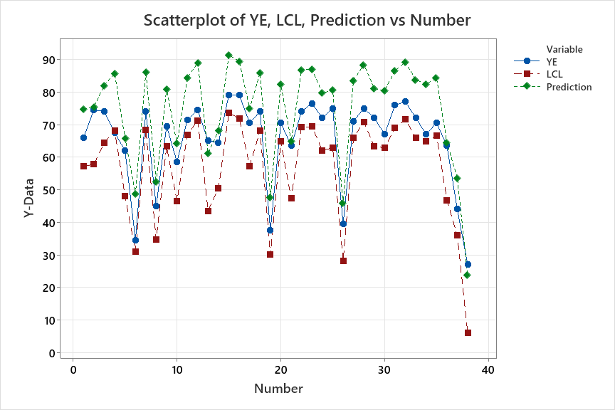
Judgement based on Anova Analysis
Noida Campus – 8C (Science)
Student Assessment | PT-TI | HYE | PT-TII | YE | LCL (Ŷi33 - 2σ) | Judgment | (Ŷi10) Predicted score
Student 1 | 65 | 72 | 90 | 66 | 57.2 | normal | 74.8
Student 2 | 68 | 70 | 83 | 75 | 57.8 | normal | 75.4
Student 3 | 90 | 75 | 83 | 74 | 64.4 | normal | 82.1
Student 4 | 98 | 76 | 95 | 68 | 68.0 | warning | 85.7
Student 5 | 43 | 61 | 90 | 62 | 48.0 | normal | 65.7
Student 6 | 30 | 44 | 80 | 35 | 31.0 | normal | 48.7
Student 7 | 98 | 76 | 90 | 74 | 68.4 | normal | 86.1
Student 8 | 63 | 55 | 40 | 45 | 34.7 | normal | 52.3
Student 9 | 85 | 78 | 85 | 70 | 63.3 | normal | 80.9
Student 10 | 48 | 56 | 88 | 59 | 46.5 | normal | 64.2
Student 11 | 88 | 72 | 100 | 72 | 66.8 | normal | 84.4
Student 12 | 98 | 79 | 98 | 75 | 71.3 | normal | 89.0
Student 13 | 45 | 65 | 63 | 65 | 43.5 | normal | 61.2
Student 14 | 90 | 56 | 55 | 65 | 50.4 | normal | 68.1
Student 15 | 100 | 80 | 100 | 79 | 73.7 | normal | 91.3
Student 16 | 98 | 79 | 95 | 79 | 71.8 | normal | 89.4
Student 17 | 63 | 72 | 88 | 71 | 57.3 | normal | 75.0
Student 18 | 95 | 80 | 88 | 74 | 68.2 | normal | 85.8
Student 19 | 40 | 47 | 60 | 38 | 30.0 | normal | 47.7
Student 20 | 85 | 80 | 88 | 71 | 64.8 | normal | 82.4
Student 21 | 50 | 57 | 83 | 64 | 47.3 | normal | 64.9
Student 22 | 90 | 77 | 100 | 74 | 69.2 | normal | 86.8
Student 23 | 95 | 80 | 90 | 77 | 69.4 | normal | 87.1
Student 24 | 88 | 69 | 83 | 72 | 62.0 | normal | 79.7
Student 25 | 93 | 63 | 85 | 75 | 62.9 | normal | 80.6
Student 26 | 43 | 46 | 48 | 40 | 28.2 | normal | 45.8
Student 27 | 85 | 77 | 95 | 71 | 65.9 | normal | 83.6
Student 28 | 95 | 79 | 98 | 75 | 70.8 | normal | 88.4
Student 29 | 78 | 78 | 90 | 72 | 63.4 | normal | 81.1
Student 30 | 83 | 77 | 88 | 67 | 62.8 | normal | 80.4
Student 31 | 93 | 78 | 93 | 76 | 68.9 | normal | 86.6
Student 32 | 98 | 80 | 95 | 77 | 71.5 | normal | 89.2
Student 33 | 90 | 73 | 93 | 72 | 66.0 | normal | 83.7
Student 34 | 80 | 78 | 98 | 67 | 64.8 | normal | 82.5
Student 35 | 90 | 72 | 98 | 71 | 66.7 | normal | 84.3
Student 36 | 35 | 60 | 93 | 64 | 46.8 | normal | 64.5
Student 37 | 33 | 56 | 75 | 44 | 35.9 | normal | 53.6
Student 38 | 5 | 38 | 18 | 27 | 6.0 | normal | 23.7

Slide 22
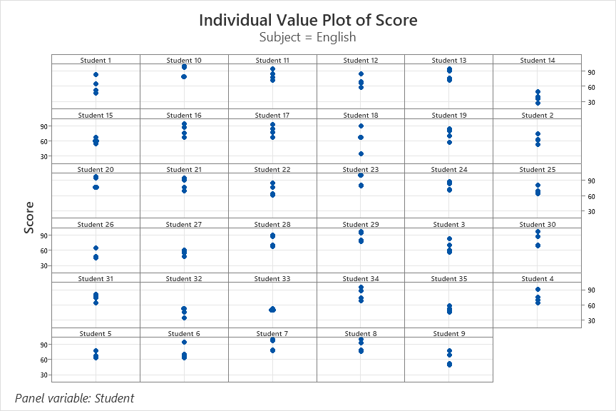
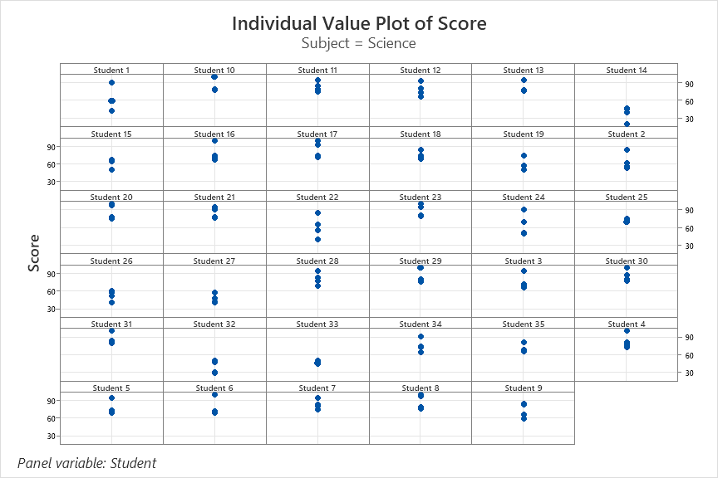
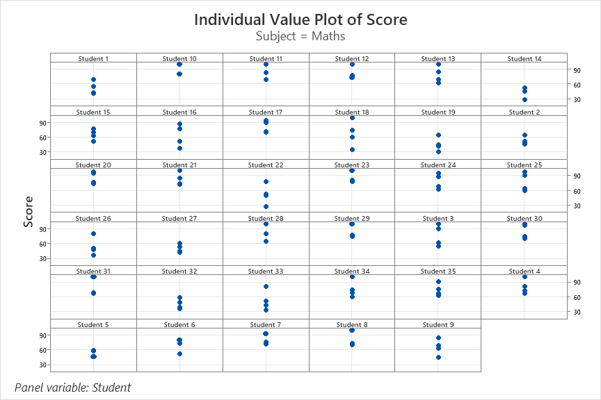
Individual value plot of score
Noida Campus – 8A

Slide 23
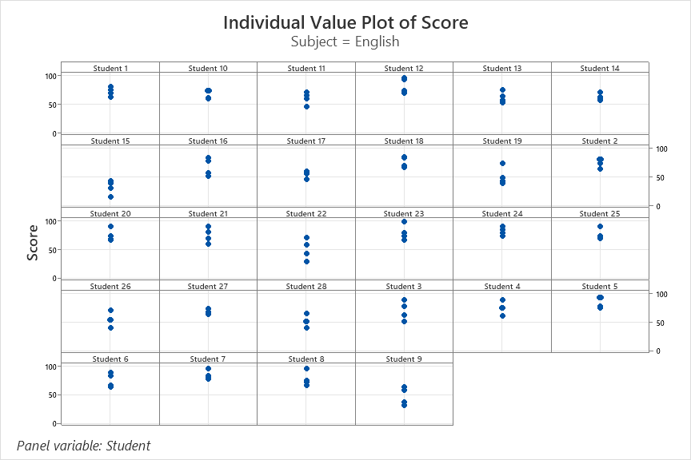
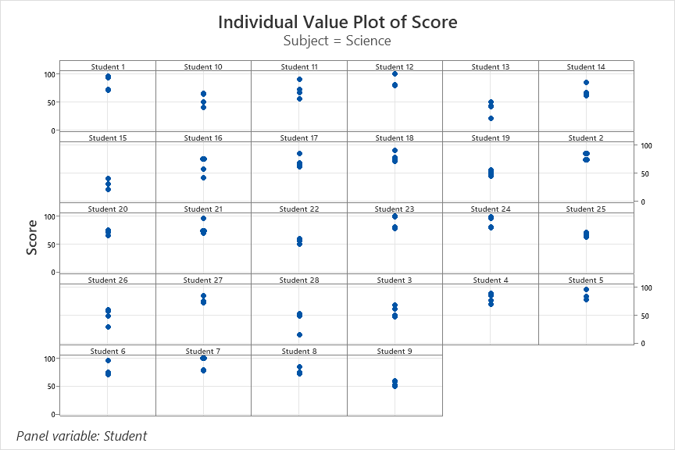
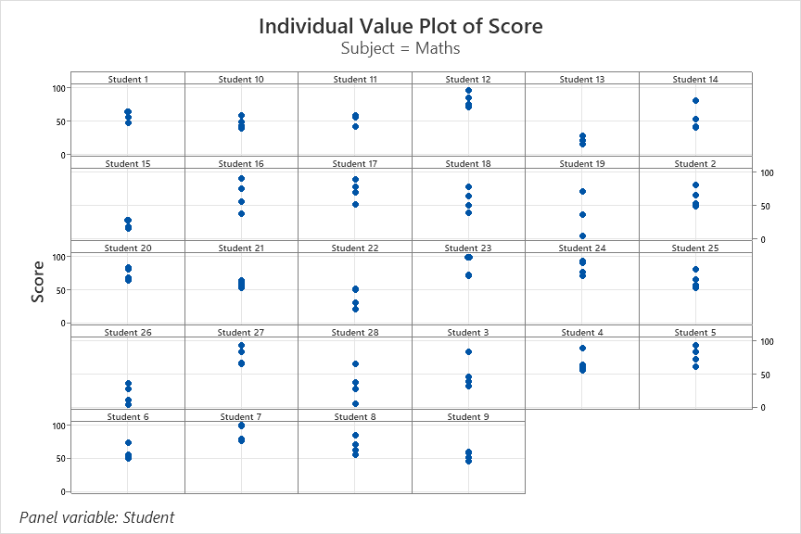
Individual value plot of score
Noida Campus – 8B

Slide 24
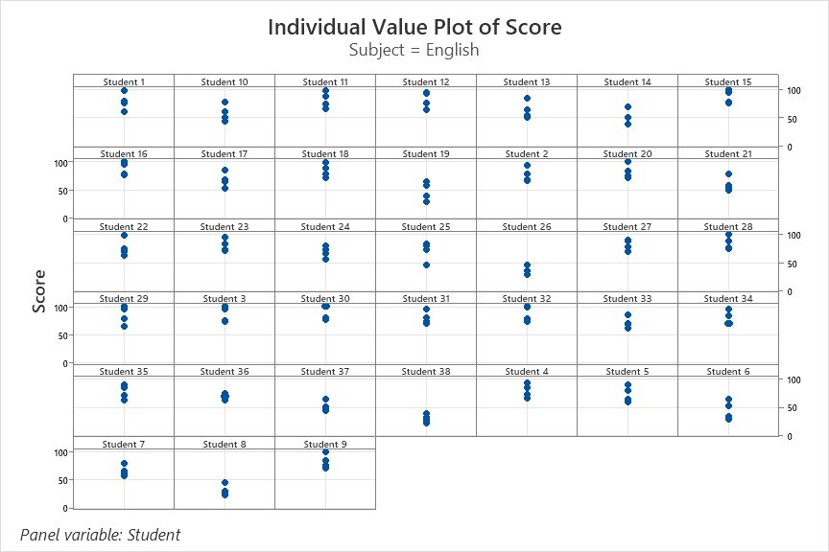
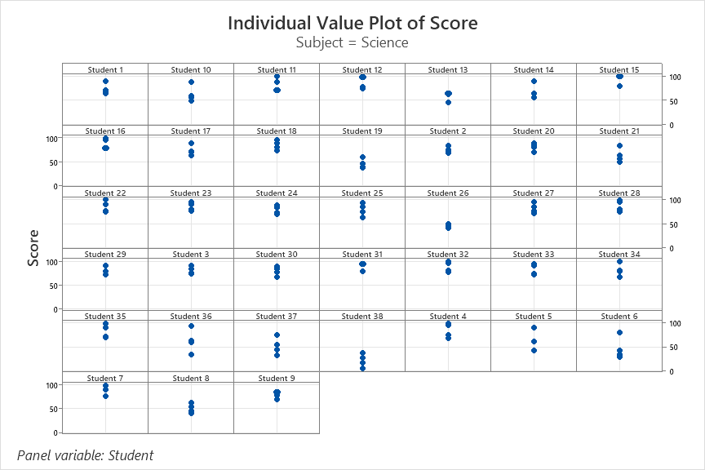
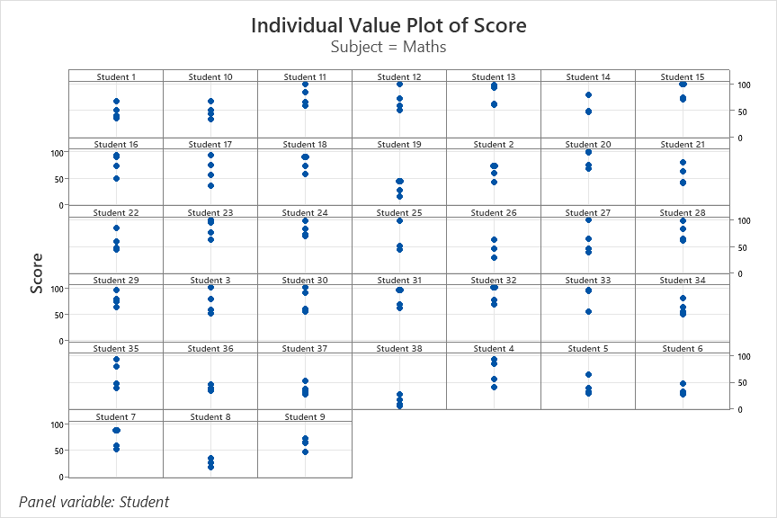
Individual value plot of score
Noida Campus – 8C

Slide 25
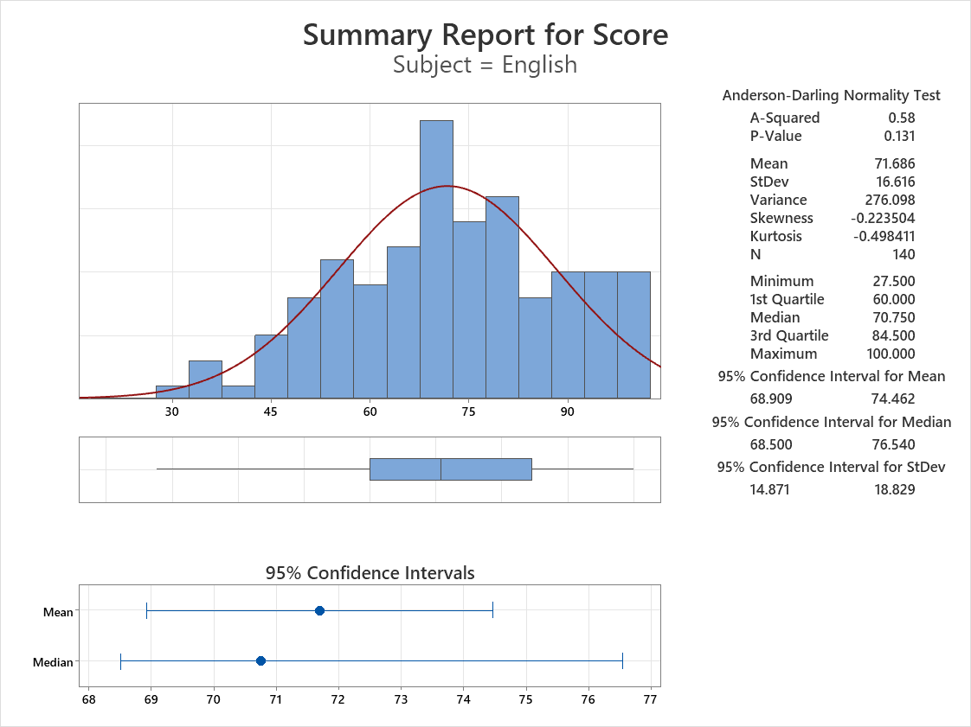
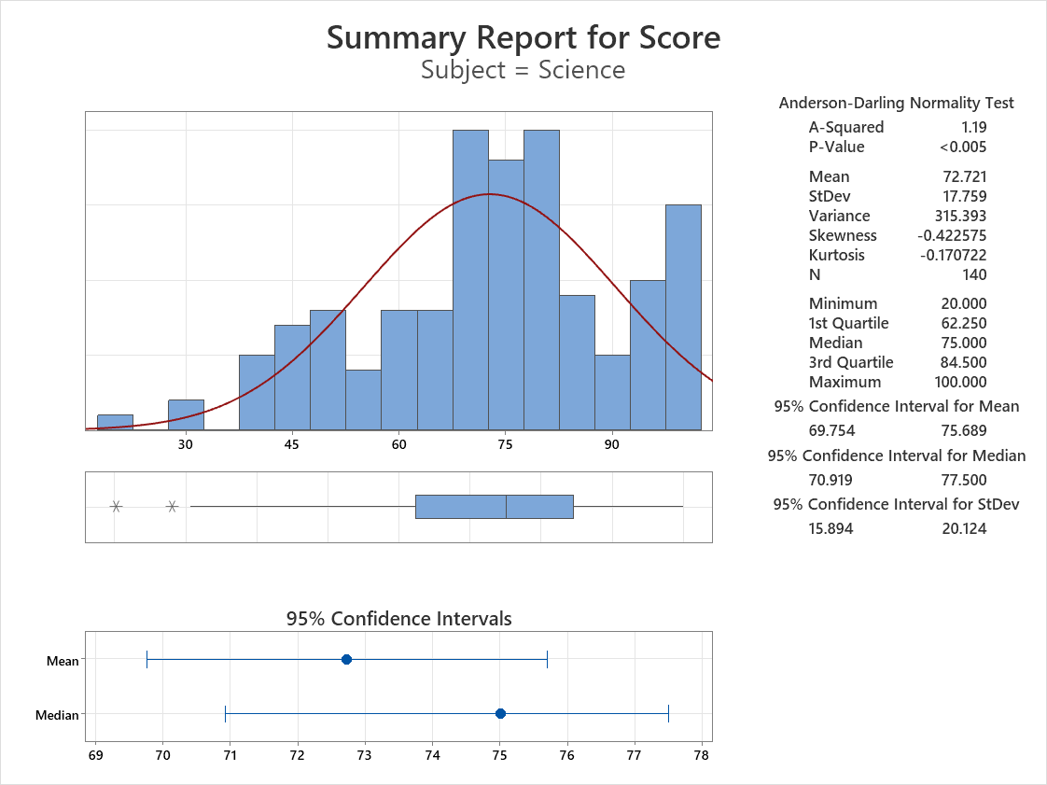
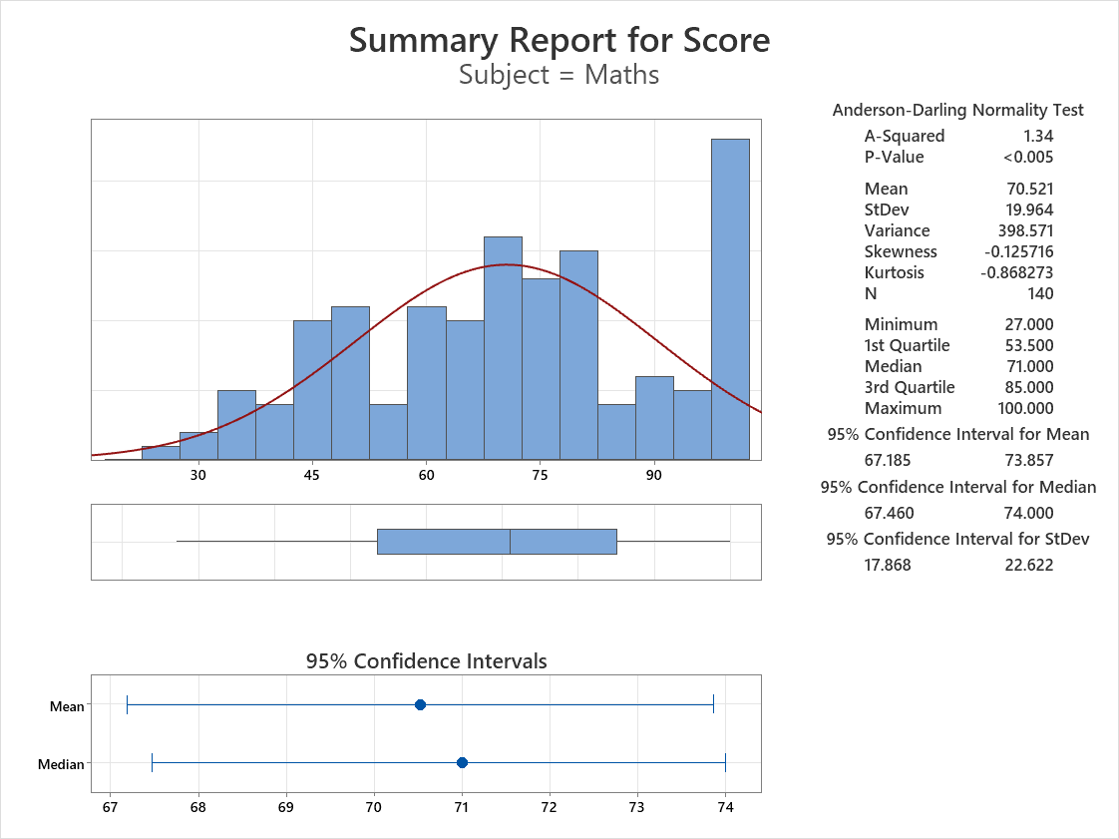
Summary report of Subject scores
Noida Campus – 8A

Slide 26
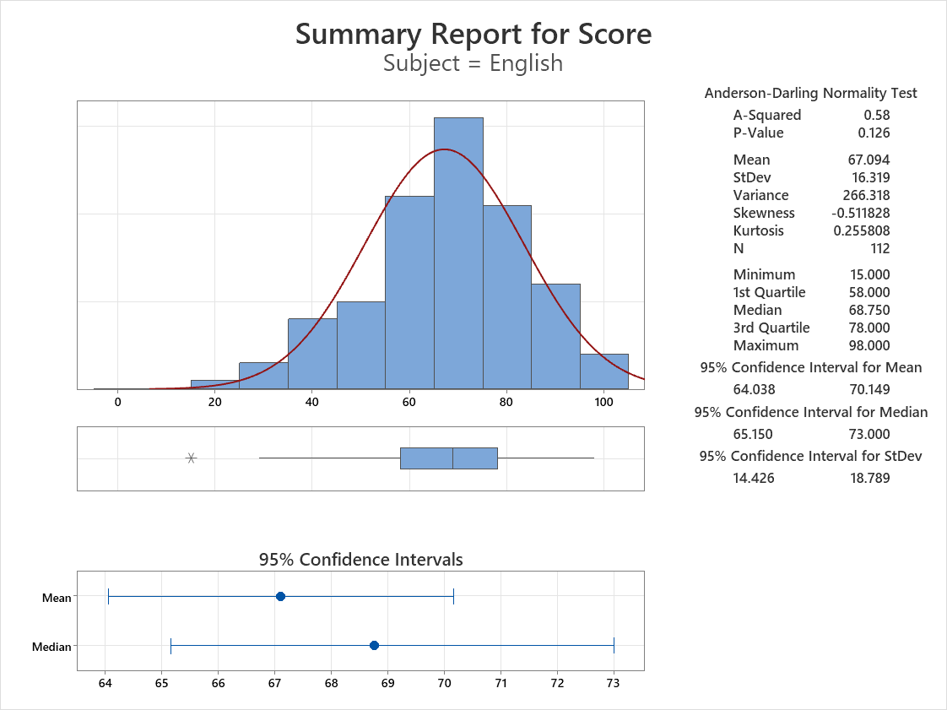
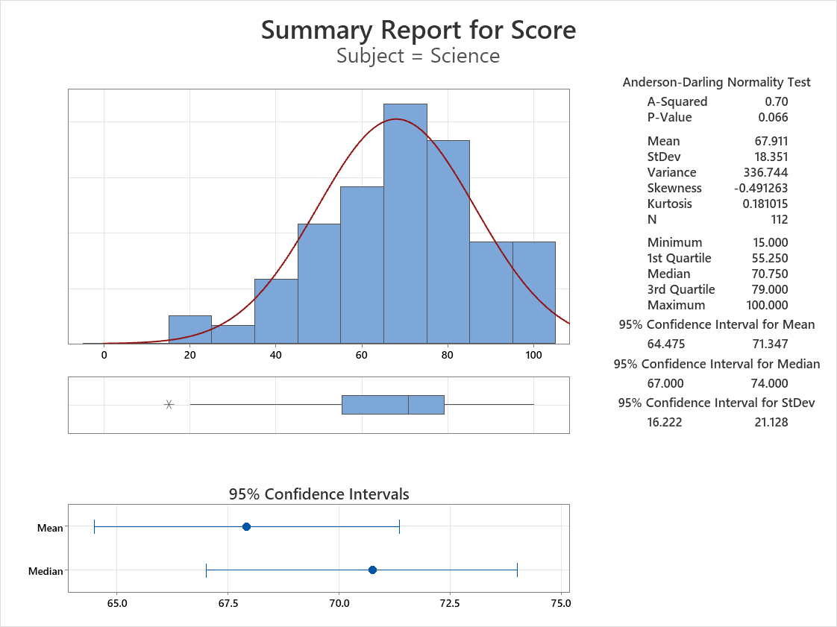
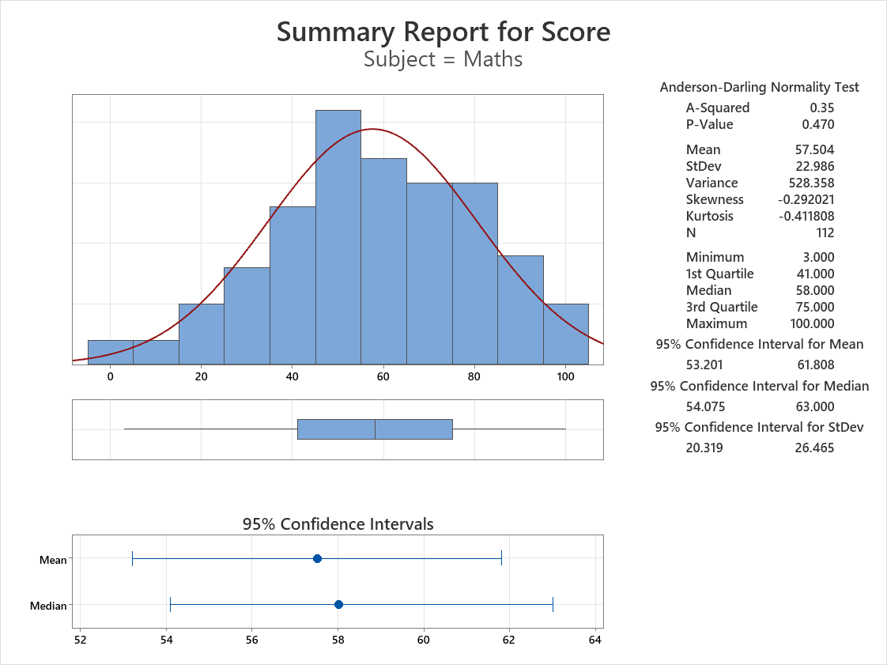
Summary report of Subject scores
Noida Campus – 8B

Slide 27
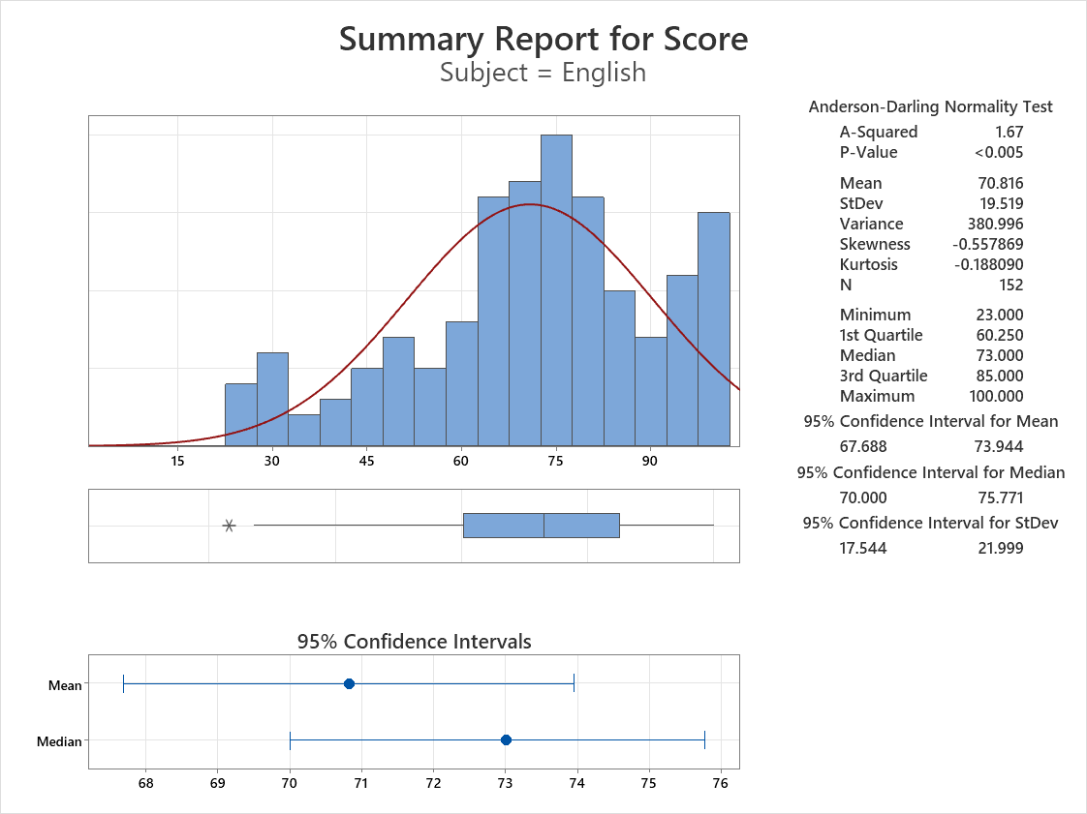
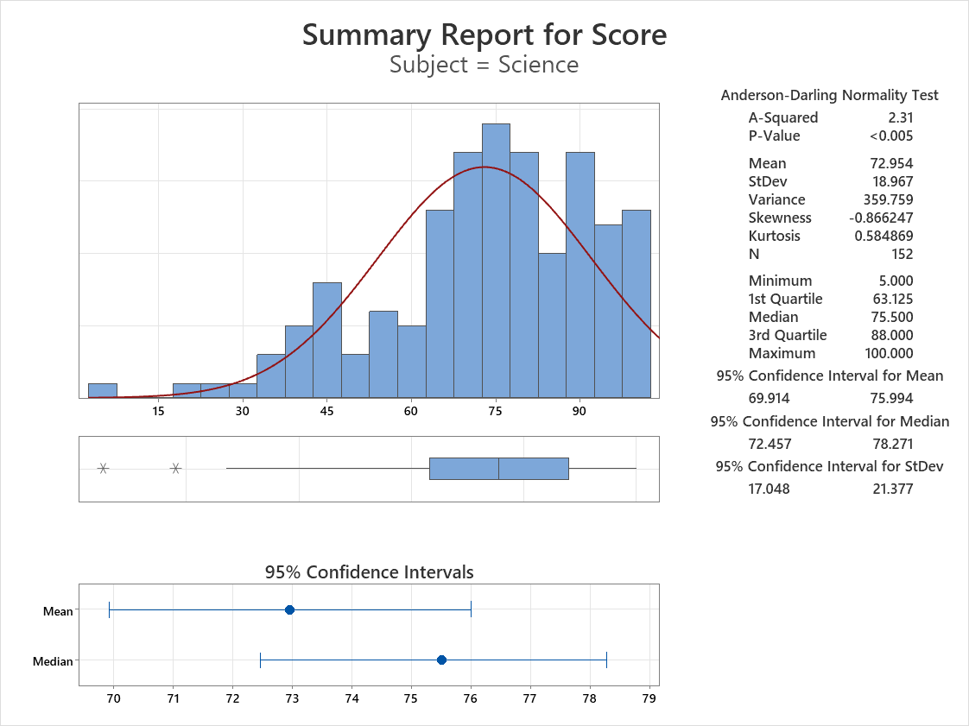
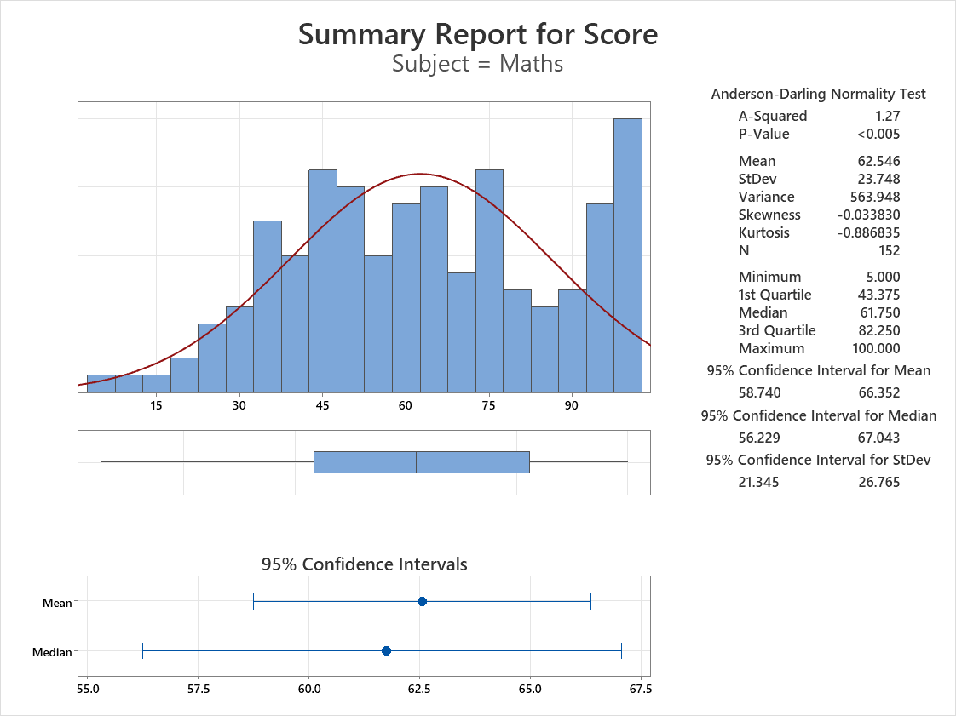
Summary report of Subject scores
Noida Campus – 8C

Slide 28
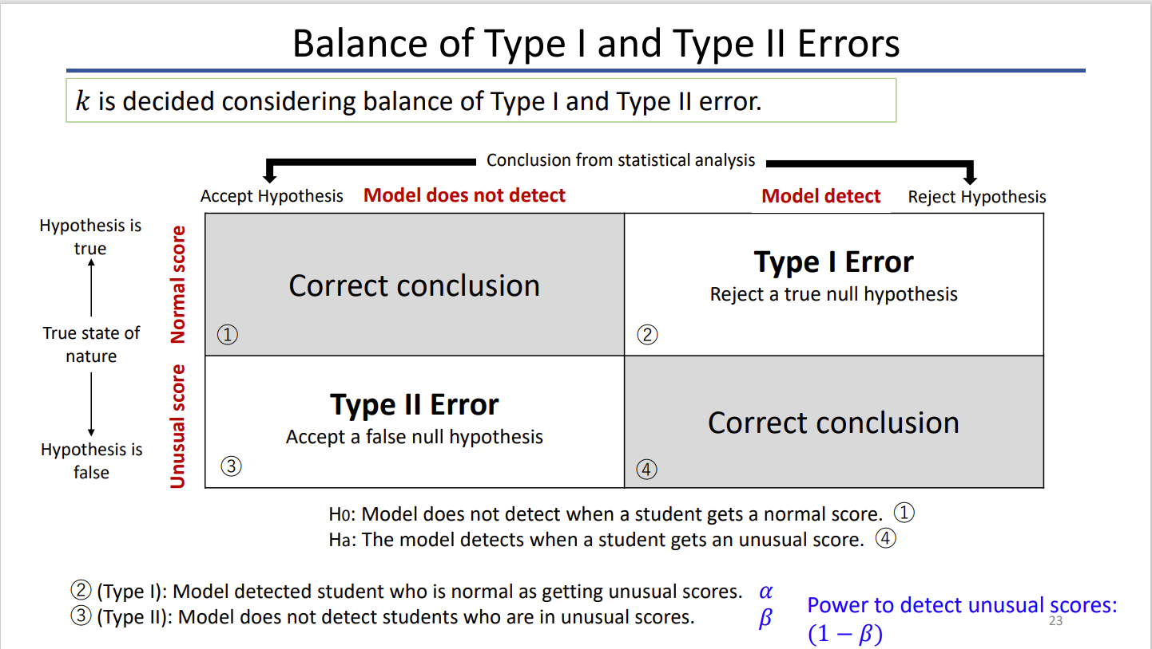
Hypothesis Explanation
Type I and Type II

Slide 29
THANK YOU

